Slide 1
Text-to-speech & Voice-to-text
Application
Submitted in the partial fulfillment for the award of the degree of
BACHELOR OF ENGINEERING
IN
CSE- IBM BIG DATA ANALYTICS
Submitted by:
AVN.Vineethsai – 18BCS3788
Divyanshu – 18BCS3781
Ashish Mehra – 18BCS3796
Akshat Sharma – 18BCS3786
Under the Supervision of:
Ms. Jothi Pruthi
Department of AIT-CSE
DISCOVER . LEARN . EMPOWER

Slide 2
Outline
Introduction to Project
Problem Formulation
Objectives of the work
Methodology used
Results and Outputs
Conclusion
Future Scope
References

Slide 3
Introduction to Project
Over the past few years, Mobile Phones have become an indispensable source of communication for the modern society. We can make calls and text messages from a source to a destination easily. It is known that verbal communication is the most appropriate modem of passing on and conceiving the correct information, avoiding misquotations. To fulfil the gap over a long distance, verbal communication can take place easily on phone calls. A path-breaking innovation has recently come to play in the SMS technology using the speech recognition technology, where voice messages are being converted to text messages. Quite a few applications used to assist the disabled make use of TTS, VTT, and translation. They can also be used for other applications, taking an example: Siri an intelligent automated assistant implemented on an electronic device, to facilitate user interaction with a device, and to help the user more effectively engage with local and/or remote services makes use of Nuance Communications voice recognition and text-to-speech (TTS) technology.

Slide 4
In this project we are working with API (Application Programming Interface) is an interface that defines interactions between multiple Software applications. We divide the some production types like:
Phonation (sound)
Fluency
Intonation
Pitch variance
Voice
In Text-To-Speech we are using Web API, and Speech Synthesis API, to convert Texts to speech in different languages. And in Voice-to-text we using Speech Recognition Web API, another component of the Web Speech API that is used to convert Voice to Texts, and then build a Web application that converts our words/sentences to text format. Coming to project result we are not preparing any working product, we decided to do application based project that will help to convert Text-to-speech & Voice-to-text.
Finally the output from the project is that application based project, research paper, report and ppt.

Slide 5
Problem Formulation
In our application we are combing Text-to-speech & Voice-to-text as single application, because now a days everyone using this Text-to-speech & Voice-to-text for their daily activities but they can’t find both at a time .So , Our aim to build that everyone can use this application at a time with very easy steps. And here we are creating front page using HTML, CSS. Here we find a problem like : Background noise, Punctuation placement, Capitalization, Correct formatting Etc… we are using different kind of API’s like Web Speech API , SpeechSynthesis, speechRecognition .So we learn about different types of API’s and completed the project successfully.

Slide 6
Objectives of the Work
In this project we have use Web Server API for the converion of text-to-speech and from voice-to-speech. While using Web Server API it uses SpeechSynthesis (text-to-speech) and VoiceRecogniton (voice-to-text) using Polymer. The Web Speech API has a main controller interface for this — SpeechRecognition — plus a number of closely-related interfaces for representing grammar, results, etc. Generally, the default speech recognition system available on the device will be used for the speech recognition — most modern OSes have a speech recognition system for issuing voice commands.
We decided to do application based project that will help to convert Text-to- speech & Voice-to-text and we divided work into following objectives.
Creating frontend page.
Learn various tools to bulid Speech-To-Text.
Learn various tools to bulid Voice-To-Speech.
Tried many types of API’s which gives accuracy to convert STT or VTS.

Slide 7
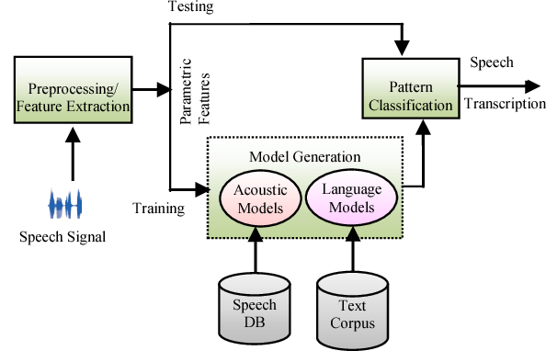
Methodology used
Application Programming Interface (API)
API stands for application programming interface, It states the rules for communication to happen, it basically takes a request and gives the response,
Voice To Text Method:
The voice to text conversion is a technique which converts language or words spoken by human into texts. Basically this is interchangeable with speechrecognition, but latter is used, to refer to the process of speech perception. For speech recognition, VTT use the same stages and idea but each phase uses a different combination of approaches.
SPEECH RECOGNITION
This method refers only program’s or machine capability to
recognise phrases and words that spoken by user and converts
it into machines format as in figure. The following parameters
can be used to classify speech recognition systems.

Slide 8
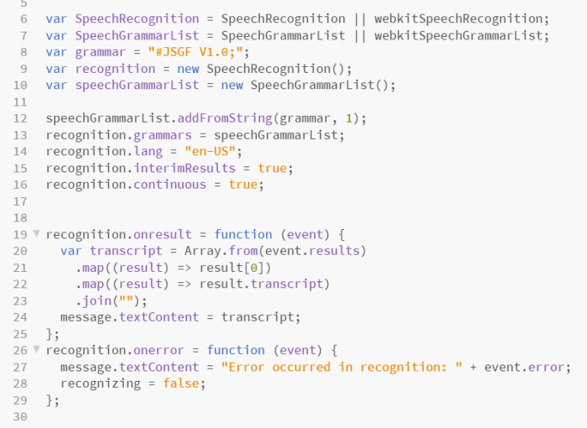
Speaker: Every speaker has different frequencies in voice. And this types are designed for only particular speaker.
Vocal Sound: Speech recognition is influenced by the manner the speaker speaks. Some models can distinguish between single utterances and utterances separated by a pause.
Vocabulary: The size of the vocabulary has a large impact on the system's complexity, performance, and precision.
Custom vocabulary
If your audio has a lot of bespoke phrases, abbreviations, and
acronyms that an off-the-shelf model would not be familiar
with, being able to define custom vocabulary is useful as
shown in figure.

Slide 9
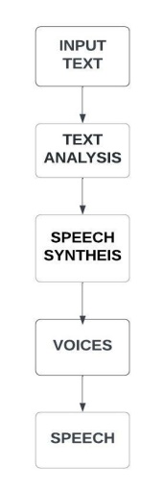
Text To Speech Method
It will convert spoken text into speech by analysing, understand, and prepared this
whole process is called Text To Speech. In this method various steps have been involved
and in above flow chart it shows in order. Although the most important phases of this
method are:
Text Processing: As shown in figure , First text will be analyse, normalised, and then
written in the phonetic and linguistic forms.
Speech Synthesis: The types of speech synthesis which we are used in this project:
Articulator Synthesis: To generate speech, a mechanical and acoustic model is used.
Formant Synthesis: Formant Synthesis stored on parametric basis by a separate speech segments.
Concatenative Synthesis: It is a method of speech generation. Concatenative speech synthesis is known to get the most natural sound in space primarily due to concatenation of national speech sound units.

Slide 10
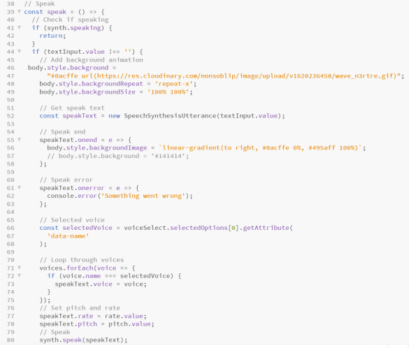
Voice function
The voices array will hold all of the voices available in the
Browser Web speech API, while as mention in figure the
getVoices function will return all of the voices available,
along with their names and languages.
Speak Function
We'll create a function speak as shown in figure. Speaking
events are handled by talk, which provides a wave background
when a voice is speaking, manages the selected voice,
controls the rate and pitch of the voice, and also handles
error.

Slide 11
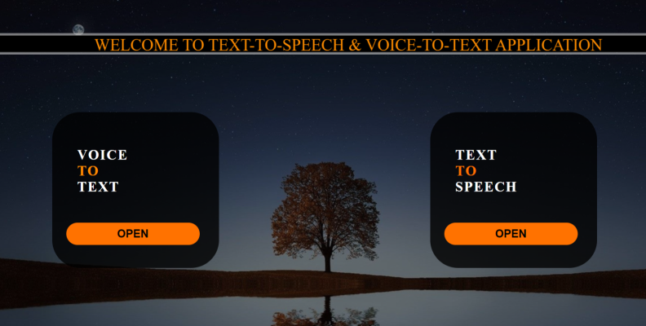
Results and Outputs
We created a simple application and it is easy for users
to use it as shown in figure. we developed the frontend
by using HTML & CSS and it is connected to
text to speech and voice to text by API.

Slide 12
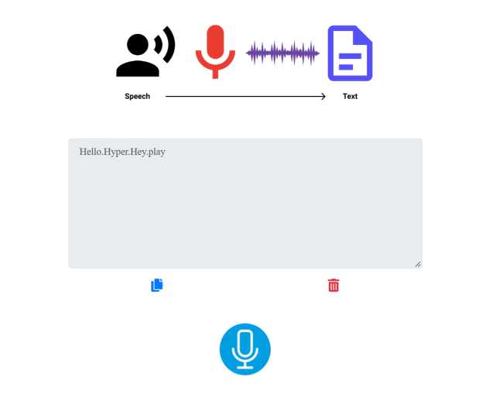
In Voice to text we used speech recognition. Here
basically speech recognition converts English words
spoken by human into text format. As shown in figure
first user needs to allow the microphone then only
recording will be start, After staring recording if
users wants to stop means we given option that users
can copy their text till it. And also if user wants to
start new conversion then we provide delete option so
that users can start from starting on it.

Slide 13
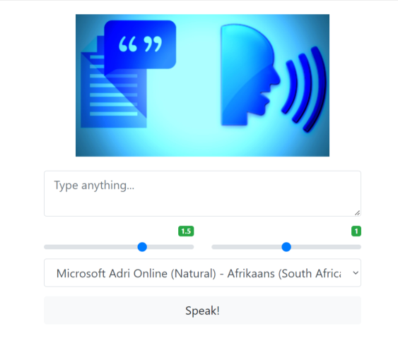
In Text to speech we used speech synthesis. Here
basically speech synthesis do analysing of English
text and converts it into speech. First user needs
to type or copy paste the text in text content box,
after below that there will be rate and pitch because
according to user convenience he/she will be set
pitch and rate as shown in figure. And here
contains all voices which are present in browser
web speech api so from it user can select it.

Slide 14
Conclusion
In this project we learned the various methods for VTT & TTS as well as their applications and usage. We can draw the following conclusion after thoroughly analysing the various speech types, voice-Recognition, speech translation, conversion of VTT & TTS: In VTT, we say that, despite its drawbacks, API is a better speech signal to text converter than the other two due to its computational feasibility. Similarly, formant synthesis, which uses parallel and cascade synthesis, is the best converter in TTS systems. Speech Synthesis translation is widely used because it combines the advantages of rule-based and statistical machine translation techniques. It create and promotes the syntactically and grammatically content correctly and also considering text is in correct format, learning ability, and data acquisition.

Slide 15
References
Pratik K. Kurzekar, Ratnadeep R. Deshmukh, Vishal B. Waghmare, Pukhraj P. Shrishrimal, A Comparative Study of Feature Extraction Techniques for Speech Recognition System, International Journal of Innovative Research in Science, Engineering and Technology (An ISO 3297: 2007 Certified Organization) Vol. 3, Issue 12, December 2014.
Ms. Anuja Jadhav, Prof. Arvind Patil, Real Time Speech to Text Con- verter for Mobile Users, National Conference on Innovative Paradigms in Engineering Technology (NCIPET-2012) Proceedings published by International Journal of Computer Applications (IJCA)
Suman K. Saksamudre, P.P. Shrishrimal, R.R. Deshmukh, A Review on Different Approaches for Speech Recognition System, International Journal of Computer Applications (0975 8887) Volume 115 No. 22, April 2015.
Sunanda Mendiratta, Dr. Neelam Turk, Dr. Dipali Bansal, Speech Recognition by Cuckoo Search Optimization based Artificial Neural Network Classifier, 2015 International Conference on Soft Computing Techniques and Implementations- (ICSCTI) Department of ECE, FET, MRIU, Faridabad, India, Oct 8-10, 2015.
Pere Pujol Marsal, Susagna Pol Font, Astrid Hagen, H. Bourlard, and C. Nadeu, Comparison And Combination Of Rasta-Plp And Ff Features In A Hybrid Hmm/Mlp Speech Recognition System, Speech and Audio Processing, IEEE Transactions on Vol.13, Issue: 1, 20 December 2004.
Suhas R. Mache, Manasi R. Baheti, C. Namrata Mahender, Review on Text-To-Speech Synthesizer, International Journal of Advanced Research in Computer and Communication Engineering Vol. 4, Issue 8, August 2015.

Slide 16
Aditi Kalyani, Priti S. Sajja, A Review of Machine Translation Systems in India and different Translation Evaluation Methodologies, Interna- tional Journal of Computer Applications (0975 8887) Volume 121 No.23, July 2015
Mouiad Fadiel Alawneh, Tengku Mohd Sembok Rule-Based and Example-Based Machine Translation from English to Arabic, 2011 Sixth International Conference on Bio-Inspired Computing: Theories and Applications
Keiichi Tokuda, Yoshihiko Nankaku, Tomoki Toda, Heiga Zen, Speech Synthesis Based on Hidden Markov Models, Proceedings of the IEEE — Vol. 101, No. 5, May 2013. Junichi Yamagishi, Member IEEE, and Keiichiro Oura
F. Seide, G. Li, D. Yu,Conversational Speech Transcription Using Context-Dependent Deep Neural Networks, In Interspeech, pp. 437440, 2011.
Kamini Malhotra,Anu Khosla, Automatic Identification of Gender Ac- cent in Spoken Hindi Utterances with Regional Indian Accents, 978-1- 4244-3472-5/08/25.00 2008 IEEE
Om Prakash Prabhakar, Navneet Kumar Sahu,”A Survey on Voice Command Recognition Technique” International Journal of Advanced Research in Computer and Software Engineering, Vol 3,Issue 5,May 2013.
Tatsuhiko KINJO, Keiichi FUNAKI,”ON HMM SPEECH RECOG- NITION BASED ON COMPLEX SPEECH ANALYSIS”,1- 4244-0136- 4/06/20.00 ’2006 IEEE
Mathias De Wachter, Mike Matton, Kris Demuynck, Patrick Wambacq, Template Based Continuous Speech Recognition,IEEE Transs. On Audio, Speech Language Processing, vol.15, issue 4,pp

Slide 17
THANK YOU….

